Slide 1
Chapter 1 Objectives
The CCNA Topics Covered in this chapter include:
  What are the basic components of router?
  IOS file system overview
  Different interface types

Slide 2
IOS – Internetworking Operating System
As with a computer, a router or switch cannot function without an operating system. Cisco calls its operating system the Cisco Internetwork Operating System or Cisco IOS.
IOS is the software that controls the routing and switching functions of internetworking system.

Slide 3
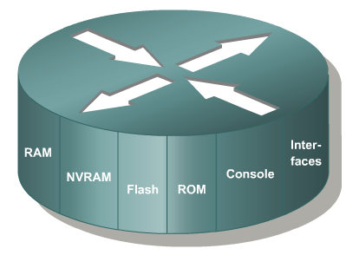
Introduction to Routers

Slide 4
Router Memory Components
ROM - Read Only Memory – Bootstrap/POST
FLASH Memory - IOS Images are kept here
- Erasable reprogrammable ROM
- Contents are kept on Power down or reload
RAM - Random Access memory
- Routing Tables
- Running Configuration
- Contents are lost on reboot
NVRAM - Start up configuration
- Configuration Register
- Contents are kept on reload

Slide 5
Read-Only Memory (ROM)
ROM has the following characteristics and functions:
Maintains instructions for power-on self test (POST) diagnostics
Stores basic operating system software
Mini IOS
Flash memory has the following characteristics and functions:
Holds the operating system image (IOS)
Retains content when router is powered down or restarted
Can store multiple versions of IOS software
Is a type of electronically erasable, programmable ROM (EEPROM)

Slide 6
Random Access Memory, also called dynamic RAM (DRAM)
RAM has the following characteristics and functions:
Stores routing tables
Holds ARP cache
Stores running IOS configurations
RAM is a volatile memory and loses content when router is powered down or restarted
The configuration present in RAM is called running-configuration
Non-Volatile RAM
NVRAM has the following characteristics and functions:
Provides storage for the startup configuration file
Content not erased when router is powered down or restarted
  Configuration Register – 16 bit register which decides boot sequence
  - default setting: 0x2102 (0x means its hexadecimal value)
Once configuration is saved, it will be saved in NVRAM and this configuration is called Startup Configuration.

Slide 7
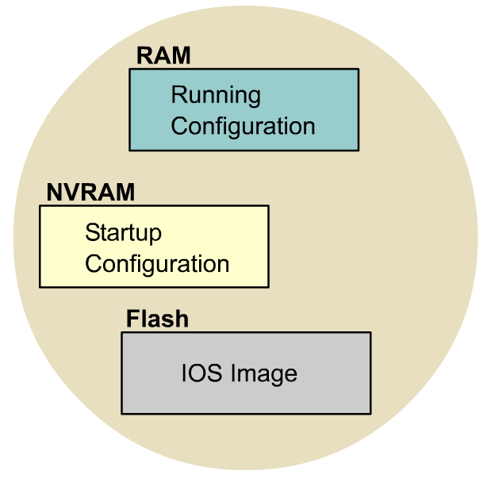
IOS File System Overview

Slide 8
Types of interfaces:
  Ethernet
  Fast Ethernet
  Gigabit Ethernet
  Serial
  Loopback
  Console
  Aux

